Slide 1


BikeShare Products Co.
September 30, 2025
A statistical analysis by Rolando Mancilla-Rojas

Slide 2



At a Glance…
BikeShare Products Co.
Busiest Times
Weakest Times
Key Takeaways
Fall Season
Month of August
Weekends (Fri, Sat, Sun)
Evening Hours (5-7PM)
Spring Season
Month of April
Weekdays (Mon, Tue, Wed)
Early Morning (3-5AM)
Improve weaker times through Promotion, Holidays (Spring, 4th of July, Labor Day)
Maintenance during early mornings.

Slide 3
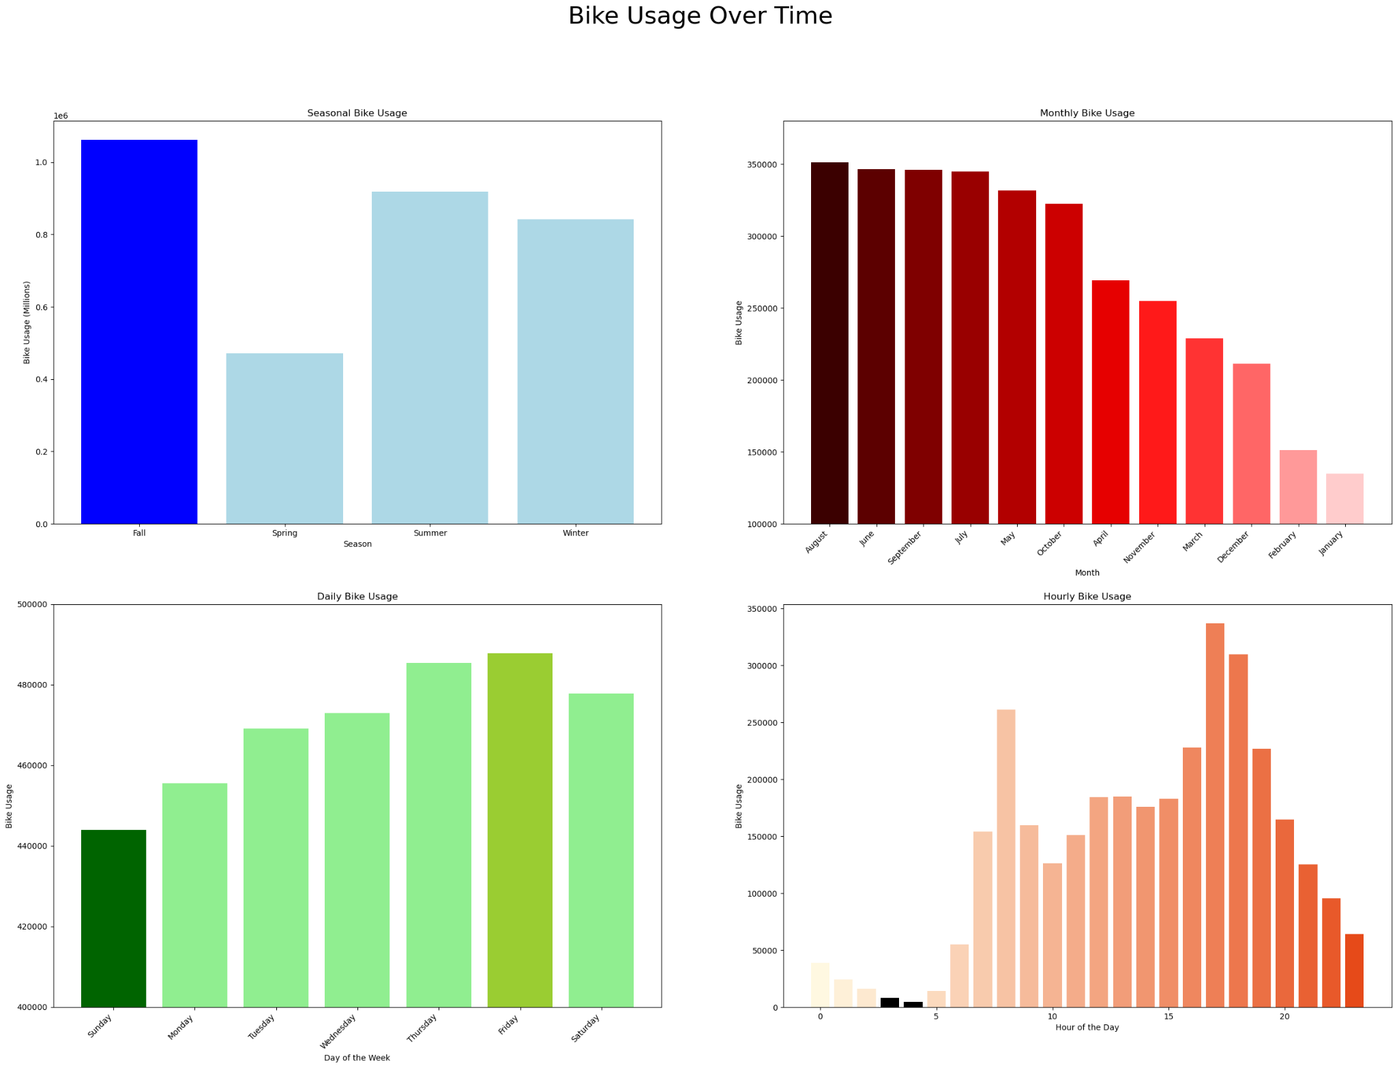
Time-Based
Insights
BikeShare Products Co.
From Top Left to Bottom Right, shows bike usage for:
Seasons
Months
Days of Week
Hours of Day
We can see that Weekend Evenings in the Fall are the most popular bike usage times.
While Weekday Early Mornings in the Spring are the weakest bike usage times.

Slide 4
However,
Holiday bike usage shows something different…
BikeShare Products Co.

Slide 5
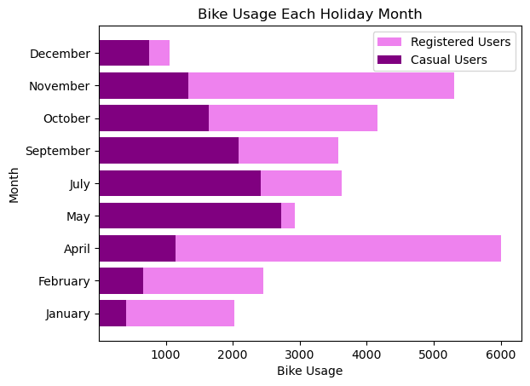
Holiday Bike Usage
BikeShare Products Co.
Casual Users: bike riders who rent for the day, occasions, do not have an account with us.
Registered Users: Frequently rent bikes, predictable times, have an account with us.
Bike Usage for the holiday days shows an interesting flip
Particularly for April and November, where they represent the highest bike usage.
There are huge potentials for marketing promotions.
Easter - (April)
Independence Day - (July)
Labor Day - (September)

Slide 6

Statistical Analysis
Do average hourly rides differ between working days and non-working days?
With our P-value being less than our alpha, we can conclude that there
is a significant difference between working days and non-working days.
Do mean hourly rides differ across categories of multi-level categorical variables such as weather condition?
Our P-value here was also less than our alpha. Post-Hoc test reveals that heavy rain conditions warrant significantly less hourly rides. This was to be expected.
BikeShare Products Co.
THE PROBLEM
THE RESULT
Note:
Our significance level for both tests was set at 0.05 as there was no need for super sensitive testing.
THE PROBLEM
THE RESULT

Slide 7

A/B Testing
BikeShare Products Co.
PM’s objective: Does ridership increase on working days during early evening after launching a small app feature change.
Our Pre-Group:
2012-08-04 → 2012-08-31
Our Post-Group:
2012-09-01 → 2012-09-28
Results:
Statistical Results showed that the new change implemented did not have a significant effect.
→ 30% probability of Type I error; Fail to find significant change
Filters:
The entry was a working day.
Between the hours of 5pm - 7pm.
Only clear or misty weather conditions.
Humidity was below 70%.

Slide 8

Focus on improving bike usage during the low times: Spring (April), Weekdays
BikeShare Products Co.
OBJECTIVES
TAKEAWAYS
Holiday Promotions
Maintenance during Early Mornings
More Staffing for Weekend Evenings
Focus on improving sales for the weaker bike usage times by promoting with holidays:
Early Morning hours (3-5AM) show very little bike usage. Use this time for repairs, maintenance, etc.
Be careful to not plan all maintenance hours during these times. There is still some bike usage here that should not be ignored.
With Weekend Evenings showing the highest bike usage times, be sure to have appropriate allocated staff and resources for these hours.
Easter
Independence Day
Labor Day
Weekdays 9-5s

Slide 9
Thank you
BikeShare should continue to be a beacon of active lifestyles by providing bikes for all!

